Slide 1
User Experience(UX) / User Interface(UI)
Nima Atashin – Mahdieh Kazemi
Sina Kargaran – Marzieh Alidadi

Slide 2
What user experience (UX) means and how it matters
User experience design
10 Usability Heuristics for User Interface Design

Slide 3
What user experience (UX) means and how it matters
Marzieh Alidadi

Slide 4
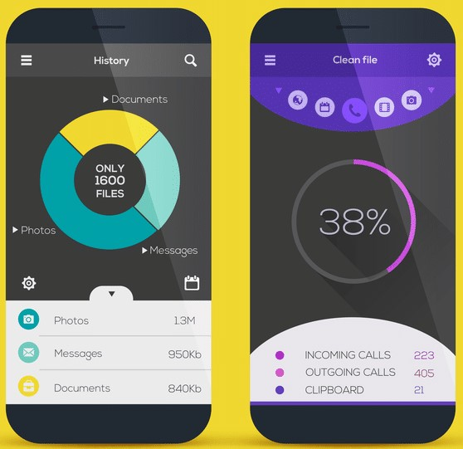
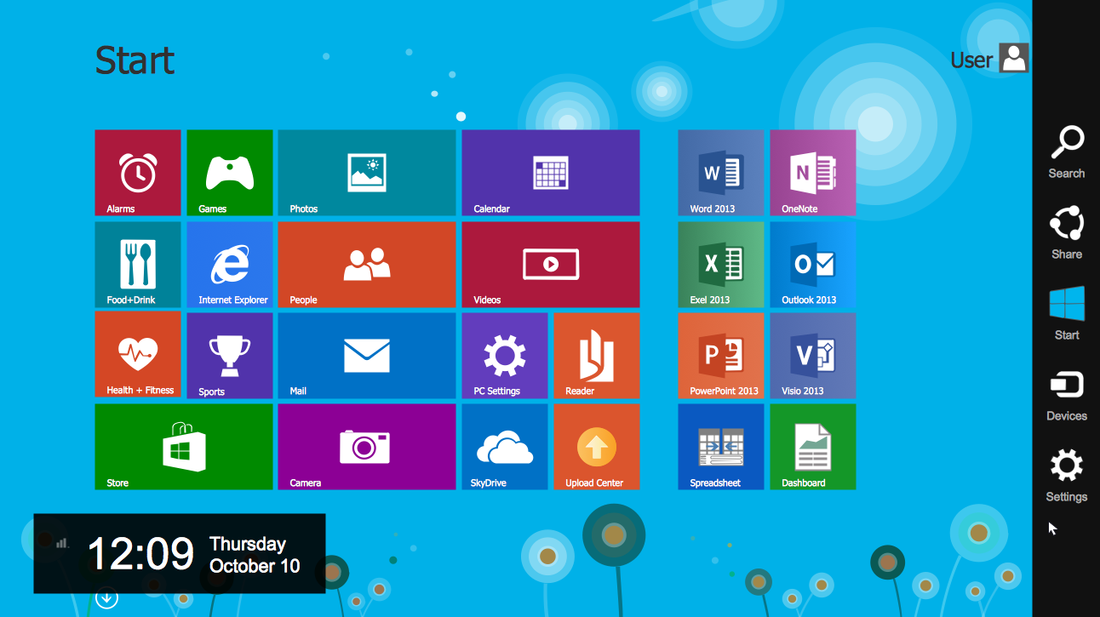
We all experience User Interfaces

Slide 5
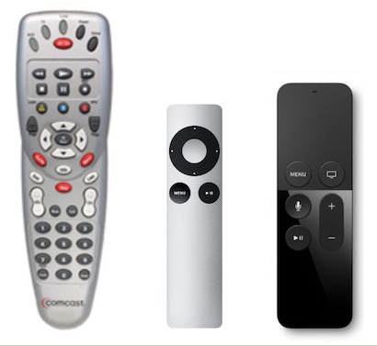
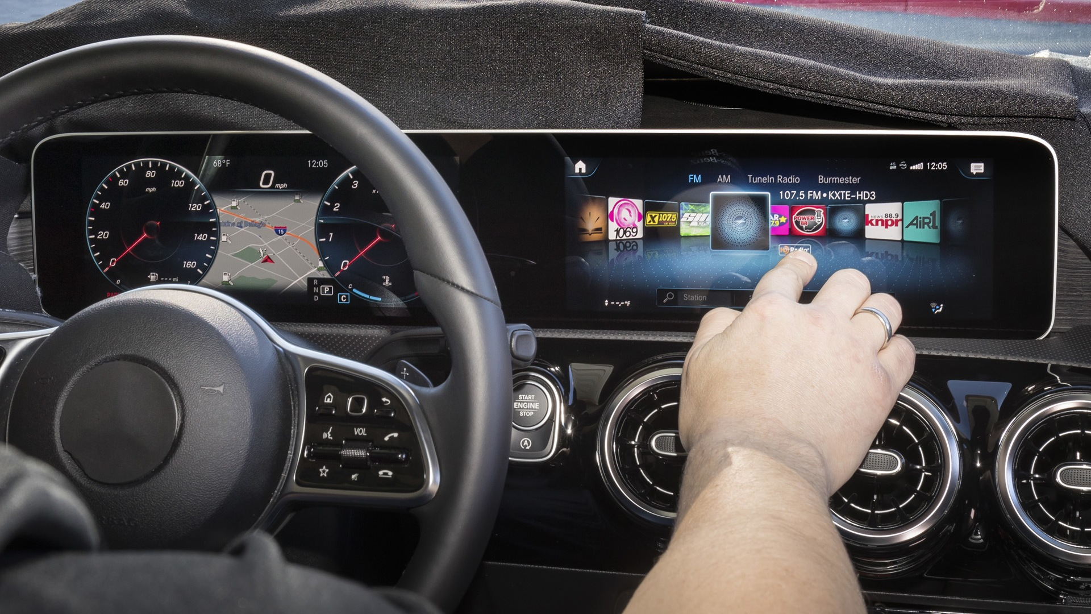
Even in a different sort

Slide 6
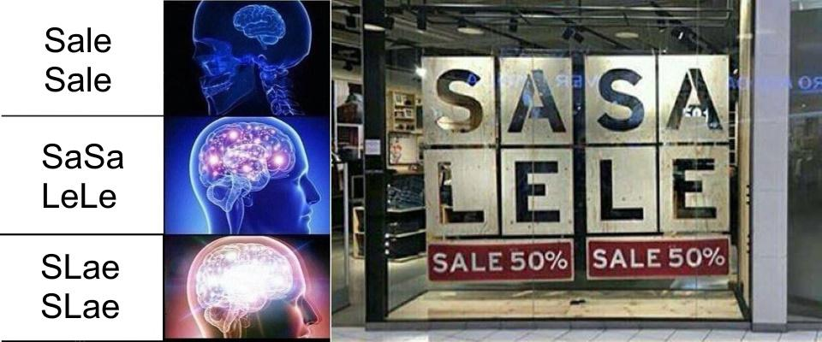
Some are cofusing

Slide 7
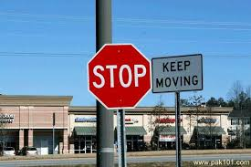
Really confusing

Slide 8
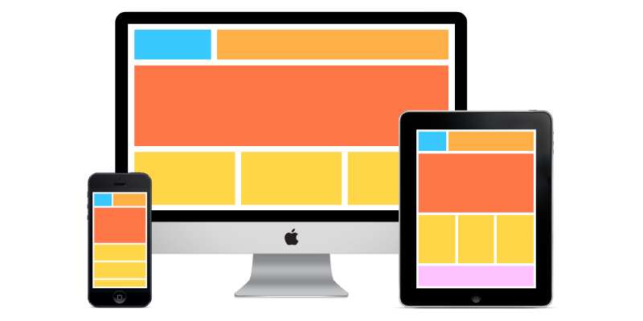
What Is User Interface? (UI)
It is the means in which a person controls a software application or hardware device.
While user interfaces can be designed for either hardware of software, most are a combination of both. For example, to control a software program, you typically need to use a keyboard and mouse, which each have their own user interface.
A good user interface provides a "user-friendly" experience, allowing the user to interact with the software or hardware in a natural and intuitive way.
https://techterms.com/definition/user_interface
https://www.webfuel.com/what-is-a-responsive-user-interface

Slide 9
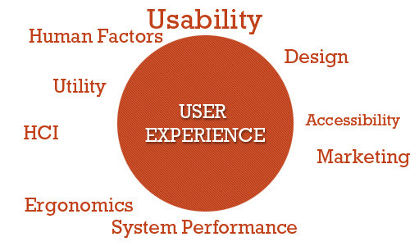
What Is User Experience? (UX)
User experience (abbreviated as UX) is how a person feels when interfacing with a system. The system could be a website, a web application or desktop software and, in modern contexts, is generally denoted by some form of human-computer interaction (HCI).
https://www.smashingmagazine.com/2010/10/what-is-user-experience-design-overview-tools-and-resources/

Slide 10
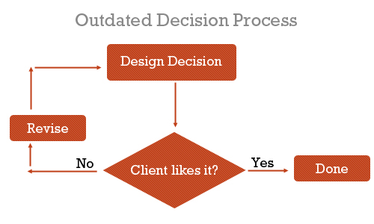
Why Is UX Important?
Nowadays, with so much emphasis on user-centered design, describing and justifying the importance of designing and enhancing the user experience seems almost unnecessary. We could simply say, “It’s important because it deals with our users’ needs — enough said,” and everyone would probably be satisfied with that.
Before our clients (and we) understood the value of user-centered design, we made design decisions based on just two things: what we thought was awesome and what the client wanted to see.
https://www.smashingmagazine.com/2010/10/what-is-user-experience-design-overview-tools-and-resources/

Slide 11
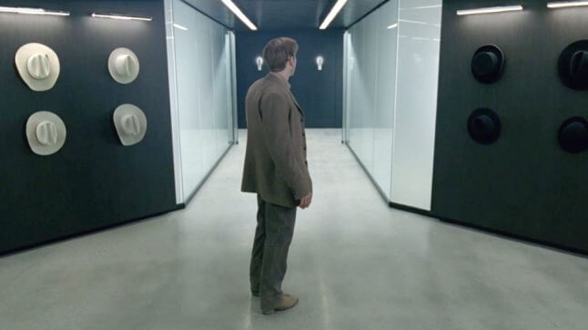
How Can Bad UX Design Kill You in the Future? (I)
For most of us, a bad user experience means only a bit of frustration or a waste of time. But in some cases, bad UX design can severely harm or even kill people. As we allow technology to infiltrate every field of our lives, bad UX design could become even more dangerous in the future. We don’t have to look that far into the future to find some dangerous UX mistakes…
https://uxstudioteam.com/ux-blog/bad-ux-design/

Slide 12
How Can Bad UX Design Kill You in the Future? (II)
- What is a “bad user experience” for you?
If you ask this question from most of the people, these would be their answers:
“When I can’t find anything. When things aren’t where they are supposed to be.”
“Waste of time, struggling. And getting annoyed.”
“I get angry and usually I leave the app or website.”
“When something is too slow for example. That’s a bad experience.”
No one talked about feeling fear, serious pain or injury. I had a feeling that bad UX design is more like an annoying fly in the room, not a serious threat. That’s also because we usually connect user experience with digital products and we think them physically harmless.
https://uxstudioteam.com/ux-blog/bad-ux-design/

Slide 13
User experience design
Mahdieh Kazemi

Slide 14
WHAT IS IT?
User experience design (UXD, UED, or XD) is the process of manipulating user behavior through usability, usefulness, and desirability provided in the interaction with a product. User experience design encompasses traditional human–computer interaction (HCI) design and extends it by addressing all aspects of a product or service as perceived by users. Experience design (XD) is the practice of designing products, processes, services, events, omnichannel journeys, and environments with a focus placed on the quality of the user experience and culturally relevant solutions. Experience design is not driven by a single design discipline. Instead, it requires a cross-discipline perspective that considers multiple aspects of the brand/ business/ environment/ experience from product, packaging, and retail environment to the clothing and attitude of employees.

Slide 15
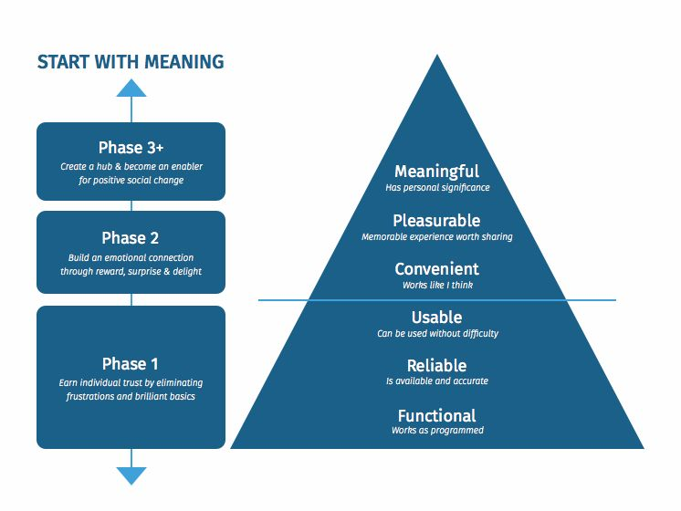
What 6 Components Do You Need for A Great UX Design?
The many components that make up great UX design are sometimes referred to as the “UX Pyramid.” These UX components, starting with the basic, must-have foundation, are:
1.Functionality: Does the product work the way it’s supposed to?
2.Reliability: Is the product readily available for use?
3.Usability: Can the user navigate the product without difficulty?
4.Convenience: Is the product intuitive?
5.Pleasurable: Is the user experience enjoyable enough to recommend to others?
6.Meaningful: Does the product hold personal significance for users?

Slide 16
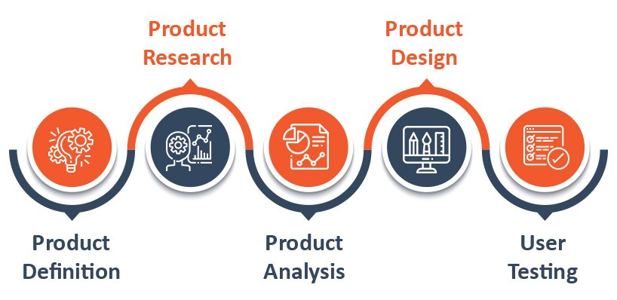
Stages of Design

Slide 17
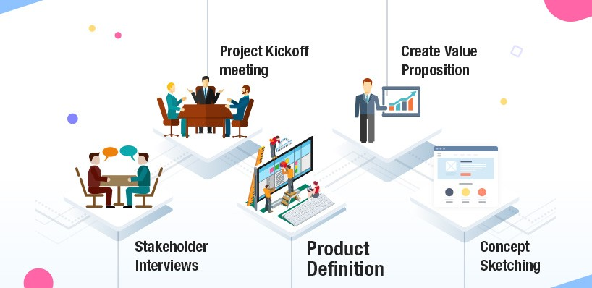
1. Product Definition
when we build a product, we need to understand its context for existence. Product definition stage sets the phase for the success of an item. During this phase, we have to brainstorm the product at the highest level with stakeholders. This Phase usually includes:

Slide 18
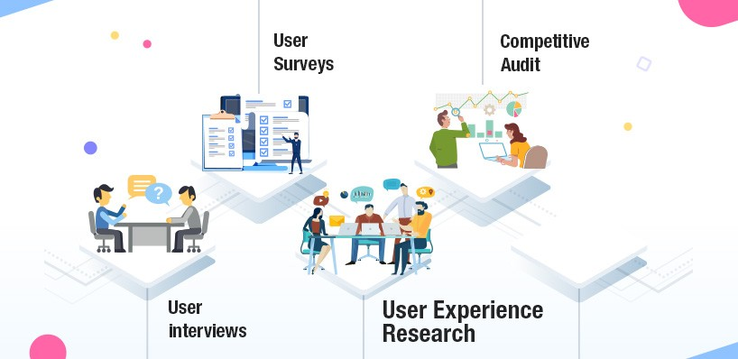
2. User Experience Research
In this phase of the design process you really come to understand your clients. In Research phase we gather information through client research, such as (interviews, field studies, etc.), mixed with some old-fashioned empathy, which will give a good idea for which user we are designing and what the user actually want's. Additionally we have to understand the requirements of stakeholders too which are as important as the end user. In research phase through documentation we can collect the data. We can collect the data through following ways :

Slide 19
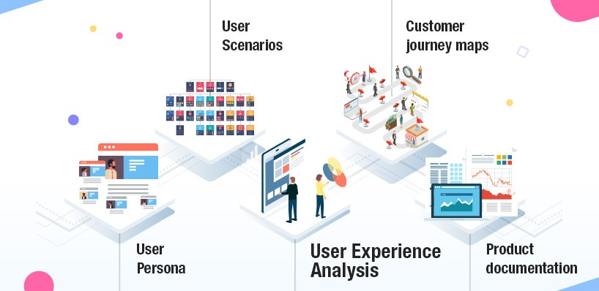
3. User Experience Analysis
Most important aim of Analysis segment is to attract insights from information accumulated for the duration of the Product research phase. Catching, arranging and making from the “what” customers want/think/need can help UX designers begin to recognize the “why” they want/think/need that. In the course of this phase, designers confirm that the most imperative suspicions being made are substantial.
This phase usually consists of:

Slide 20
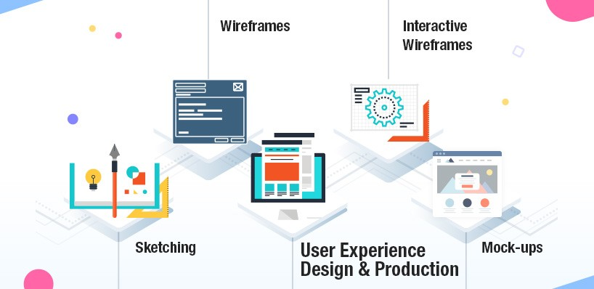
4. User Experience Design & Production
This phase usually includes: Great, liberal void area can make the absolute messiest interfaces look welcoming and straightforward. Downplay content. Ensure that content is all around upheld on all gadgets or maintain a strategic distance from it. Need to Make page description short and to the point.
The design phase usually includes :
Design – Make approaches to give them what they need (“developed the product right”).

Slide 21
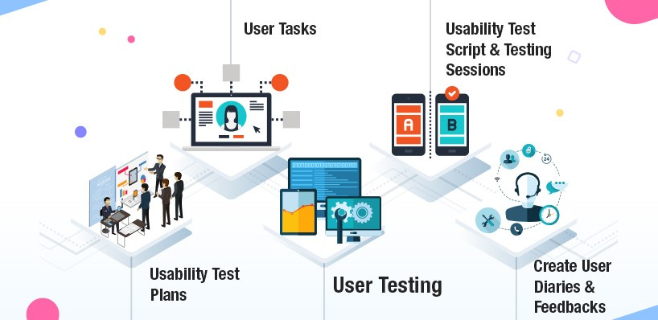
5. User Testing
Usability testing have much influence on design decisions. It guarantees you aren't driving clients into unnatural ways of conduct, and furthermore balance partner input. Try not to confuse user testing as the last stage – for the most part the consequences of the tests lead to additionally research and modifications. Ordinarily, the testing stage begins when the high-fidelity design is finished. An product is approved with stakeholders and end-users through the series of client testing sessions.
User Testing – Confirm your outcomes with clients, or find what you have to change.

Slide 22
10 Usability Heuristics for User Interface Design by Jakob Nielsen
Nima Atashin
https://www.nngroup.com/articles/ten-usability-heuristics/
https://medium.com/@erangatl/10-usability-heuristics-explained-caa5903faba2

Slide 23
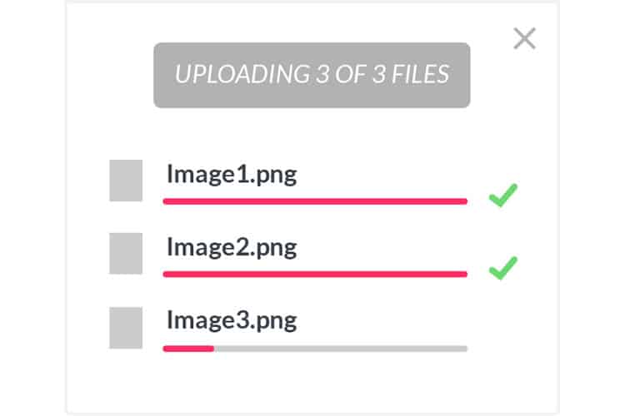
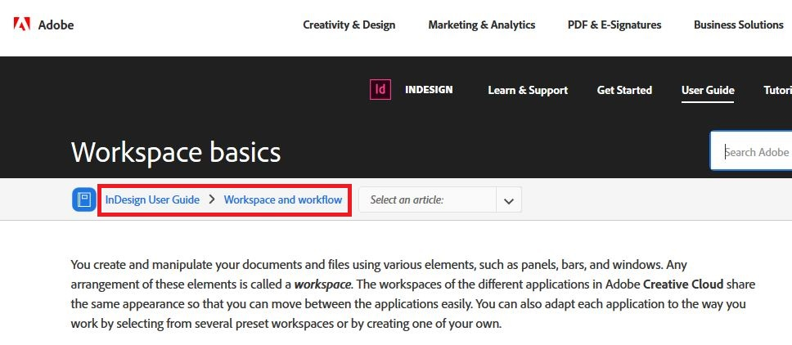
1: Visibility of system status
The system should always keep users informed about what is going on, through appropriate feedback within reasonable time.

Slide 24

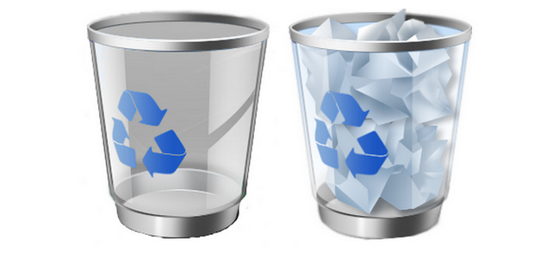
2: Match between system and the real world
The system should speak the users' language, with words, phrases and concepts familiar to the user, rather than system-oriented terms.

Slide 25
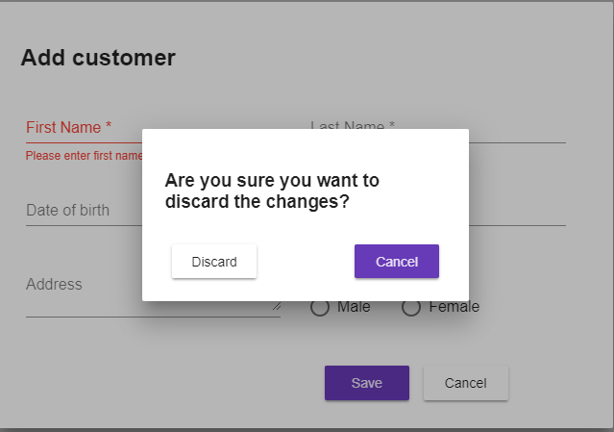
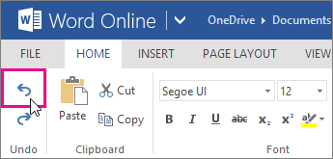
3: User control and freedom
Users often choose system functions by mistake and will need a clearly marked "emergency exit" to leave the unwanted state. Support undo and redo.

Slide 26

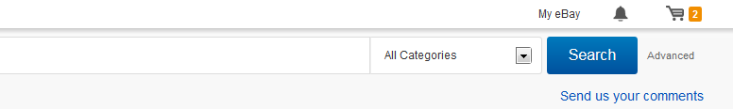
4: Consistency and standards
Users should not have to wonder whether different words, situations, or actions mean the same thing.
You will always find sign-in, profile details and shopping cart information at the top right corner.

Slide 27
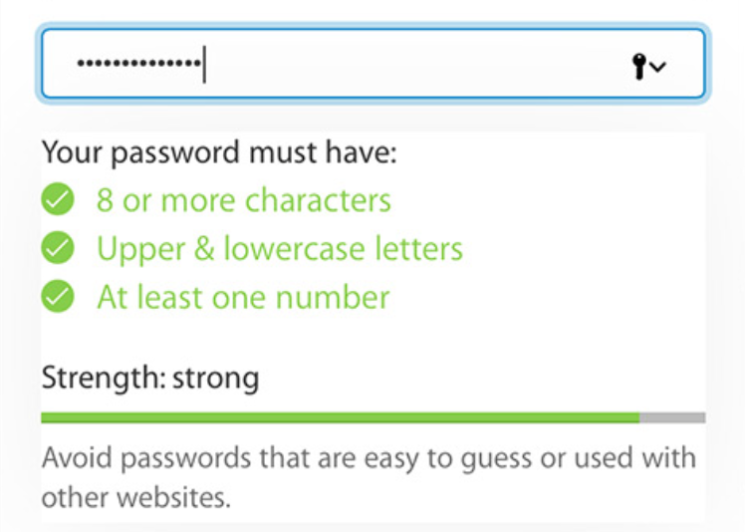
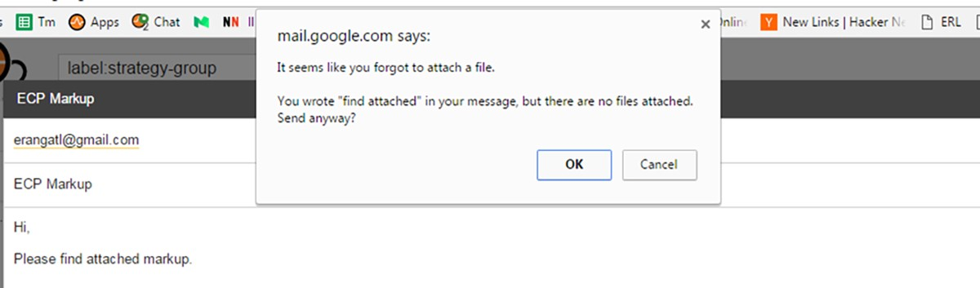
5: Error prevention
Even better than good error messages is a careful design which prevents a problem from occurring in the first place. Either eliminate error-prone conditions or check for them and present users with a confirmation option before they commit to the action.

Slide 28
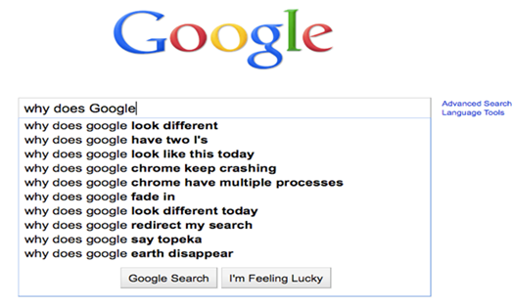
6: Recognition rather than recall
Minimize the user's memory load by making objects, actions, and options visible. The user should not have to remember information from one part of the dialogue to another. Instructions for use of the system should be visible or easily retrievable whenever appropriate.
When you google, it gives you list suggestions as you type in based on your previous searches and related most searches. It also lists your matching bookmarks as well.

Slide 29
7: Flexibility and efficiency of use
In user-interface design, we often focus on first-time users. But, in many cases, the system will be used again and again. So designing for expert users means we must balance learnability with productivity and efficiency.
An accelerator is a UI feature that speeds up an interaction or process.
Common accelerators include:
Keyboard shortcuts
Macros (allowing users to link together certain actions, to be triggered via a single control)
Touch gestures (e.g., long press, double tap, swipe)

Slide 30
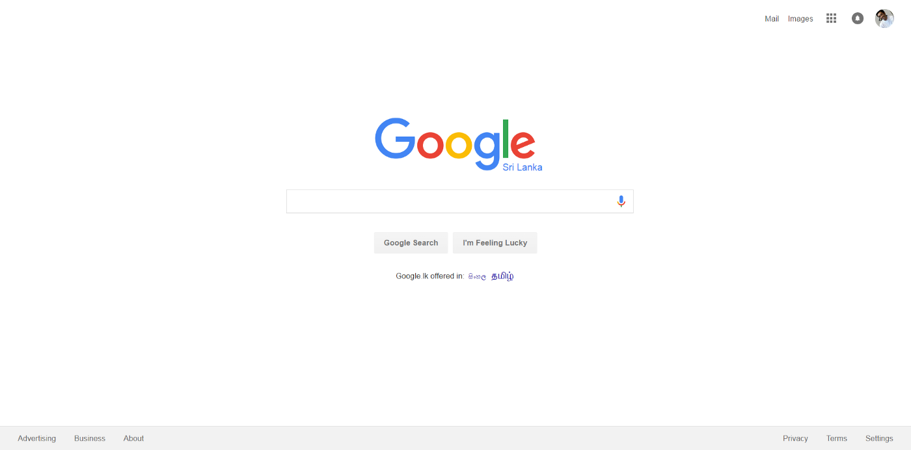
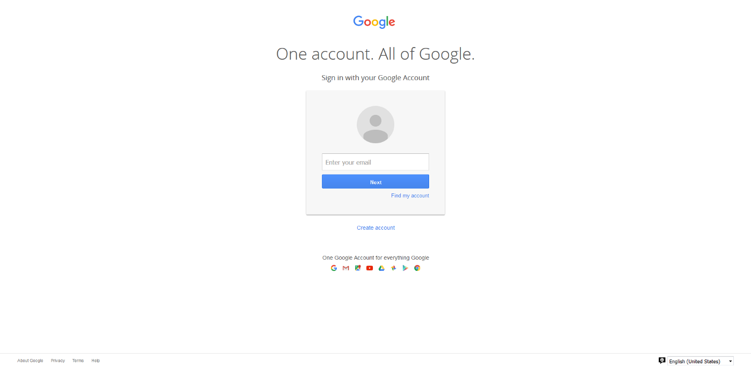
8: Aesthetic and minimalist design
Dialogues should not contain information which is irrelevant or rarely needed.
Google search and account login is an excellent example of minimalist design, and it has only the required information to perform the primary task.

Slide 31
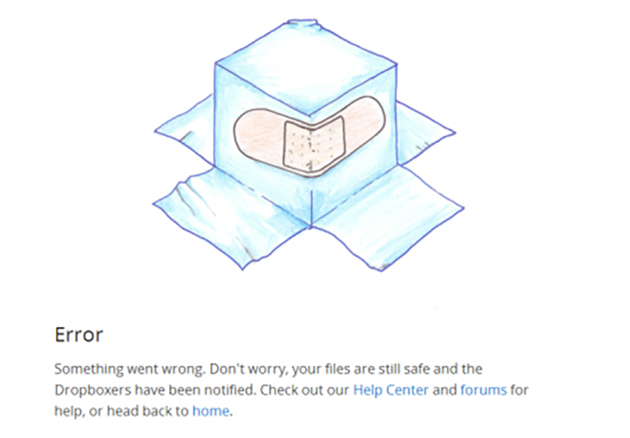
9: Help users recognize, diagnose, and recover from errors
Error messages should be expressed in plain language (no codes), precisely indicate the problem, and constructively suggest a solution.

Slide 32
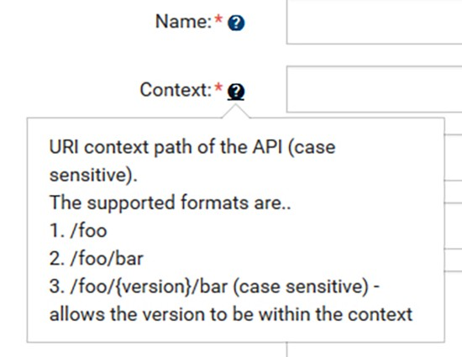
10: Help and documentation
Even though it is better if the system can be used without documentation, it may be necessary to provide help and documentation. Any such information should be easy to search, focused on the user's task, list concrete steps to be carried out, and not be too large.

Slide 33
conclusion
What user experience (UX) means and how it matters
User experience design
10 Usability Heuristics for User Interface Design

Slide 34
References
https://www.newbreedmarketing.com/blog/ask-an-expert-what-is-user-experience-ux-design
https://www.cisin.com/coffee-break/technology/best-ux-design-process-and-its-methodologies-what-clients-need-to-know.html
https://www.nngroup.com/articles/ten-usability-heuristics/
https://medium.com/@erangatl/10-usability-heuristics-explained-caa5903faba2
https://techterms.com/definition/user_interface
https://www.webfuel.com/what-is-a-responsive-user-interface
https://uxstudioteam.com/ux-blog/bad-ux-design/
https://www.smashingmagazine.com/2010/10/what-is-user-experience-design-overview-tools-and-resources/

